Slide 1

LEARNING Chapter-3
Raheela Tariq

Slide 2
DEFINITIONS OF LEARNING
Dollard Miller: Modification of behavior due to past experience.
Learning is acquiring new knowledge, behaviors, skills, values, preferences or understanding, and may involve synthesizing different types of information.
. Learning is a relatively permanent change in behavior brought about by experience.
(Feldman)

Slide 3
Types Of Learning
Trial Error(Thorndike)
Insight(Wolfgang Kholer)
Imitation or Observation (Albert Bandura)
Cognitive (E.C. Tolman)
Conditioning(Classical(Ivan Pavlov&Operant(B.F.Skinner)

Slide 4
Trail Error (Thorndike)
Different possible configurations are generated, after a test of their "fitness", the good ones are retained, and the bad ones or "errors" are eliminated.
Trial & error is a general method Of problem solving for obtaining knowledge, or reaching a solution by trying out various means and theories until errors are eliminated.

Slide 5
The most characteristic form of learning of both lower animals and man was identified by Thorndike as trial and error learning. A trial is defined as the length of time , a number of errors involved in single reaching of the goal.

Slide 6
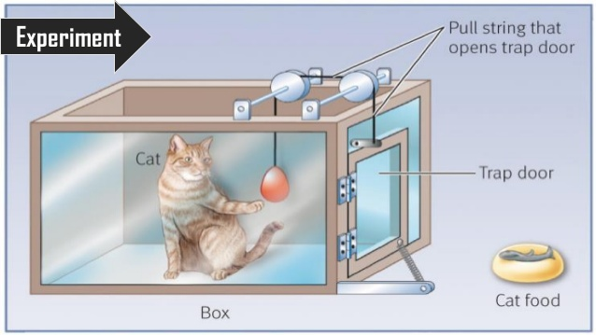
Experiment

Slide 7
Insight
. Insight learning is a type of learning or problem solving that happens all-of-a-sudden through understanding the relationships various parts of a problem rather than through trial and error.
. A type of learning that uses reason, especially to form conclusions, inferences, or judgments, to solve a problem.

Slide 8
Kohler constructed a variety of problems for the
chimps, each of which involved obtaining food
that was not directly accessible. In the simplest
task, food was put on the other side of a barrier.
Dogs and cats in previous experiments had
faced the barrier in order to reach the food, rather
than moving away from the goal to circumvent
the barrier. The chimps, however, presented with
An apparently analogous situation, set off
immediately on the circuitous route to the food.

Slide 9
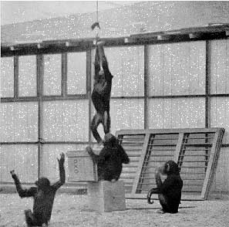

Slide 10
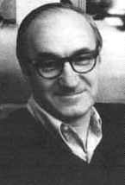
Imitation and observation (Albert Bandura)
Behaviorism, with its emphasis on
experimental methods, focuses on variables we can observe, measure, and manipulate, and avoids whatever is subjective, internal, And unavailable -- i.e. mental. Four steps are involved ,ATTENTION,RETENTION,MOTOR REPRODUCTION AND REINFORCEMENT.
Positive role model lead to positive learning.

Slide 11
Basic Processes
Four processes by Bandura
Attention: Paying attention to other’s behavior and its consequences.
Retention: Storing a mental representation in memory.
Reproduction: Enacting a modeled response by converting stored mental images into overt behavior.
Motivation: You encounter a situation, in which you reproduce an observed response.

Slide 12
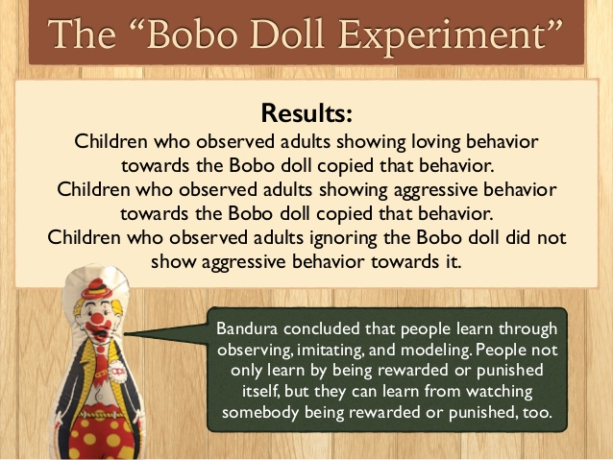
Experiment

Slide 13
Cognitive Learning
E.C. Tolman
Learning as developing from bits of knowledge and cognitions about the environment and how the organism relates to it.
Also called latent learning. (latent=hidden)
Becomes clear when a person has an incentive to display it.
Learning can occur even without reinforcement.
Observing behavior is the only way to measure learning.
For example: I know many songs but I am not singing them right now.

Slide 14
"Cognitive learning is the result of listening, watching, perceiving or experiencing.“
Cognitive maps are mental representations of the lay out of one’s environment.
Cognitive learning is a powerful mechanism that provides the means of knowledge, and goes well beyond simple imitation of others.

Slide 15
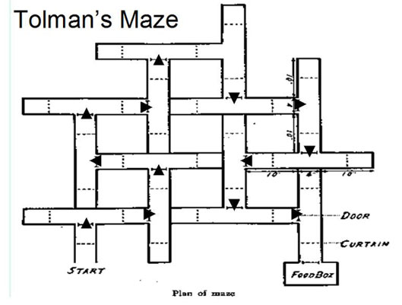
Experiment
Rats learned about mazes in which they roamed even when they were unrewarded for doing so.
Rats would acquire a cognitive map of the maze.
Learning remained hidden until they were motivated to follow the rapid routes for food goals.

Slide 16
Conditioning
Conditioning is learning by association, it consist in associating one experience with another that is already familiar to us. Two types of conditioning.
Classical Conditioning
Operant Conditioning

Slide 17
Classical Conditioning (Ivan Pavlov)
Classical Conditioning (also Pavlovian or Respondent Conditioning) is a form of associative learning that was firstly demonstrated by Ivan Pavlov .
The typical procedure for inducing classical conditioning involves presentations of a neutral stimulus along with a stimulus of some significance.
The neutral stimulus could be any event that does not result in an overt behavioral response from the organism under investigation. Pavlov referred to this as a Conditioned Stimulus (CS).
Conversely, presentation of the significant stimulus necessarily evokes an innate, often reflexive, response. Pavlov called these the Unconditioned Stimulus (US) and Unconditioned Response (UR), respectively.
If the CS and the US are repeatedly paired, eventually the two stimuli become associated and the organism begins to produce a behavioral response to the CS. Pavlov called this the Conditioned Response (CR).

Slide 18
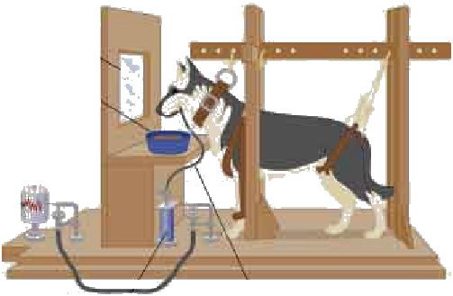
Experiment
Observation screen
Container of meat powder
Revolving drum for recording responses
Tube for collection of saliva
Device to count drops of saliva

Slide 19
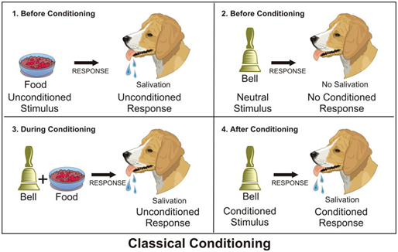

Slide 20
Stimuli & Responses
Acquisition
Extinction
Spontaneous Recovery
Generalization
Discrimination

Slide 21
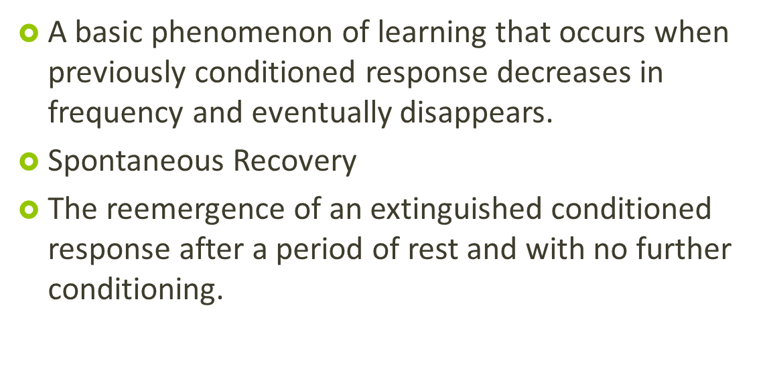
Principles of conditioning

Slide 22
Generalization
Tendency to respond to a stimulus that is similar to but different from a conditioned stimulus.
The ability to differentiate between stimuli is called Discrimination

Slide 23
Other Observations Made by Pavlov
Stimulus Generalization: Once the dog has learned to salivate at the sound of the bell, it will salivate at other similar sounds.
Extinction: If you stop pairing the bell with the food, salivation will eventually cease in response to the bell.
Spontaneous Recovery: Extinguished responses can be "recovered" after an elapsed time, but will soon extinguish again if the dog is not presented with food.
Discrimination: The dog could learn to discriminate between similar bells (stimuli) and discern which bell would result in the presentation of food and which would not.
Higher-Order Conditioning: Once the dog has been conditioned to associate the bell with food, another unconditioned stimulus, such as a light may be flashed at the same time that the bell is rung. Eventually the dog will salivate at the flash of the light without the sound of the bell.

Slide 24
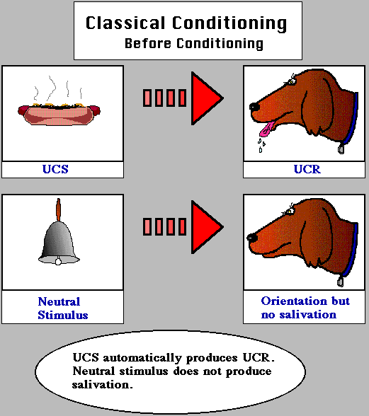
Unconditional

Slide 25
In order to have classical or respondent conditioning, there must exist a stimulus that will automatically or reflexively elicit a specific response. This stimulus is called the Unconditioned Stimulus or UCS because there is no learning involved in connecting the stimulus and response.

Slide 26
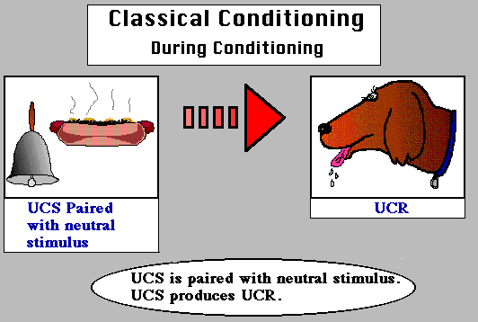
During Conditioning

Slide 27
During conditioning, the neutral stimulus will first be presented,
followed by the unconditioned stimulus. Over time, the learner will develop an association between these two stimuli (i.e., will learn to make a connection between the two
stimuli)

Slide 28
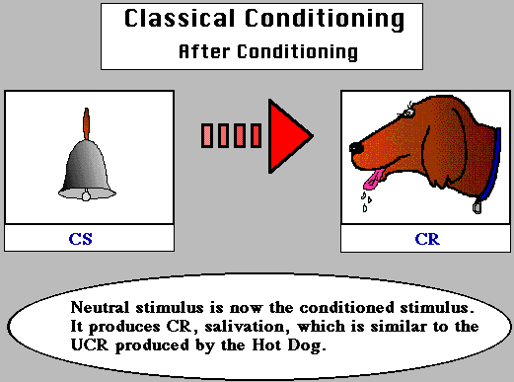
After Conditioning

Slide 29
After conditioning, the previously neutral or orienting
stimulus will elicit the response previously only elicited by
the unconditioned stimulus. The stimulus is now called a
conditioned stimulus because it will now elicit a different
Response as a result of conditioning or learning. The
response is now called a conditioned response because
it is elicited by a stimulus as a result of learning.

Slide 30
Watson's Experiment
Watson demonstrated classical conditioning in an experiment involving a young child (Albert) and a white rat. Originally, Albert was unafraid of the rat; but Watson created a sudden loud noise whenever Albert touched the rat. Because Albert was frightened by the loud noise, he soon became conditioned to fear and avoid the rat. The fear was generalized to other small animals. Watson then "extinguished" the fear by presenting the rat without the loud noise. Some accounts of the study suggest that the conditioned fear was more powerful and permanent than it really was. His work demonstrated the role of conditioning in the development of emotional responses to certain stimuli. This may explain certain fears, phobias and prejudices that people develop

Slide 31
Case Study
Identify the UCS, UCR, CR, & CS for the following:
1. You get stung by a bee and now you sweat when you hear a buzzing noise.
2. You turn left at an intersection and get hit by another car and are now feel your heart race anytime you turn left.

Slide 32
Rubrics
1. The CR & UCR are both fear (and the behavior that goes with fear—sweating). The learned stimulus for fear (CS) is the buzzing (it didn’t make you afraid before you were stung). The original fear causing-stimulus is the pain of the sting (UCS)
2. The CR & UCR are fear (and any behaviors that go with fear—heart racing). The learned stimulus for fear (CS) is the turning left (it didn’t make you afraid before you were hit). The original fear causing-stimulus is the loud noise/physical shock of the accident (UCS).

Slide 33
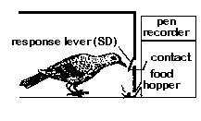
Operant Conditioning:
(B.F. Skinner)

Slide 34
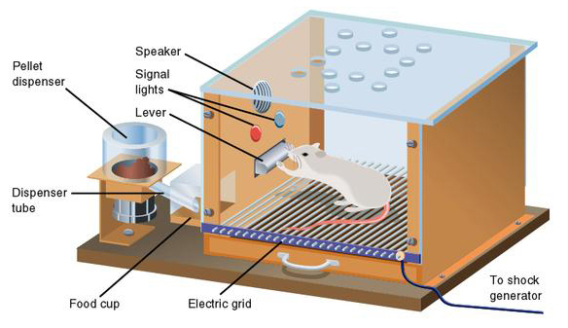
Experiment
Rat was placed in metal cage with a number of levers.
The rat first accidently pressed the levers in the cage, causing food or water to drop into a dish.
After repeating the action, the rat saw that it could receive food and water by pressing the lever. (learned behavior),
When the rat was rewarded, it was conditioned to repeat this positive action and continue being rewarded.

Slide 35
Skinner learned through experimentation that behaviour can be conditioned by using both positive and negative reinforcement. Positive reinforcement conditions the mouse to find the end of the maze in this illustration. The mouse is rewarded with food when it reaches the first turn in the maze (A). Once the first kind of behaviour becomes ingrained, the mouse is not rewarded until it makes the second turn (B). After many times through the maze, the mouse must reach the end of the maze to receive its reward (C).

Slide 36
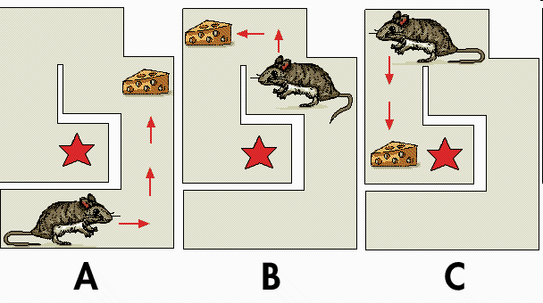

Slide 37
Operant conditioning can be defined as a type of learning in which voluntary (controllable; non-reflexive) behavior is strengthened if it is reinforced and weakened if it is punished (or not reinforced).
For Example, to get an animal to learn how to press a lever, the experimenter will use small rewards after each behavior that brings the animal toward pressing the lever. So, the animal is placed in the box. When it takes a step toward the lever, the experimenter will reinforce the behavior by presenting food or water in the dish (located next to or under the lever). Then, when the animal makes any additional behavior toward the lever, like standing in front of the lever, it is given reinforcement (note that the animal will no longer get a reward for just taking a single step in the direction of the lever). This continues until the animal reliably goes to
the lever and presses it to receive reward.

Slide 38
Reinforcement, punishment, and Extinction
Reinforcement is a consequence that causes a behavior to occur with greater frequency.
Punishment is a consequence that causes a behavior to occur with less frequency.
Extinction is the lack of any consequence following a behavior.

Slide 39
Positive reinforcement occurs when a behavior (response) is followed by a favorable stimulus (commonly seen as pleasant) that increases the frequency of that behavior. In the Skinner box experiment, a stimulus such as food or sugar solution can be delivered when the rat engages in a target behavior, such as pressing a lever.
Negative reinforcement occurs when a behavior (response) is followed by the removal of an aversive stimulus (commonly seen as unpleasant) thereby increasing that behavior's frequency. In the Skinner box experiment, negative reinforcement can be a loud noise continuously sounding inside the rat's cage until it engages in the target behavior, such as pressing a lever, upon which the loud noise is removed.

Slide 40
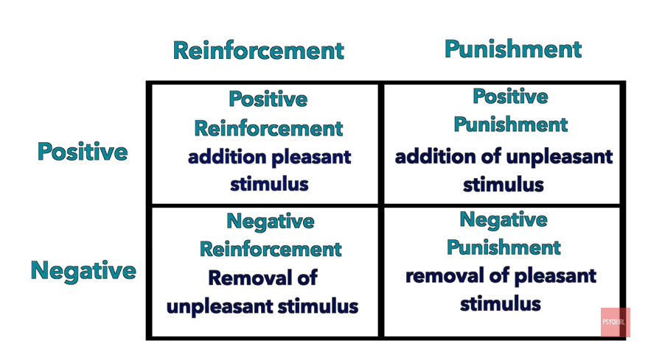

Slide 41
Factors Influencing Learning
Motivation
Reward and Punishment
Interest
Group Participation
Amount
Familiarity
Meaningfulness

